Slide 1
Digital Portfolio
STUDENT NAME: M. Anitha
REGISTER NO AND NMID: 2024C07 AND 1451222407460
DEPARTMENT: B.Sc ( Computer science)
COLLEGE: Mahalashmi women’s college of arts and science

Slide 2
INTERACTIVE PUBLIC

Slide 3


AGENDA
Problem Statement
Project Overview
End Users
Tools and Technologies
Portfolio design and Layout
Features and Functionality
Results and Screenshots
Conclusion
Github Link
3/21/2024 Annual Review

Slide 4

PROBLEM STATEMENT
A problem Statement is a concise description of a current issue, The desired future state, and the gap between the two, used to clarify what needs to be addressed in a project, proposal, or research. It provides context, Identifies the specific problem and it’s impact and explains why a solution or further study is necessary.

Slide 5

PROJECT OVERVIEW
A group engaging with a product, service, or idea through feedback, social media, forums, events, and gamification.- *Characteristics*: Active participation, two-way communication, collaboration, and dynamic engagement.- *Examples*: Online communities, social media groups, public forums, gamified platforms, and crowdsourcing initiatives.
My Portfolio contains About me and my project, Skills, Contact.

Slide 6
END USERS
It Highlights innovation, collaboration, and empowerment. It promotes inclusion, scalability, and sustainable growth. The platform enhances productivity, collaboration, and decision-making.

Slide 7

TOOLS AND TEHNOLOGIES
HTML, CSS, and JS:Front-end Development Powerhouse"Building the Web, One Line of Code at a Time."HTML: Structure & Semantics- Building blocks of the web- Content organization and accessibilityCSS: Visual Design & Layout- Pixel-perfect design and layout- Responsive and adaptable interfacesJS: Dynamic Interactivity- Bringing the web to life- Interactive and immersive experiencesCodePen: Front-end Innovation Hub- Showcasing creativity and expertise

Slide 8
POTFOLIO DESIGN AND LAYOUT
portfolio design and layout are crucial for showcasing skills and experiences. A well-structured portfolio should include:- Home/About Me: Introduction and personal statement- Projects: Showcase of relevant work and accomplishments- Skills: Technical and soft skills highlighting expertise- Contact: Call-to-action for viewers to get in touchKey Takeaways- Clean design and clear narrative- Visual hierarchy and intuitive flow- Responsive and mobile-friendly design
8

Slide 9
FEATURES AND FUNCTIONALITY
Futures1. *Responsive Design*: Adapts to various devices and screen sizes.2. *Interactive Elements*: Incorporate animations, transitions, and scrolling effects.3. *Customizable*: Allow users to personalize the layout, colors, and fonts.4. *Accessibility*: Ensure your PPD is accessible on various devices and for users with disabilities.Functionalities1. *Easy Navigation*: Simple and intuitive navigation for seamless user experience.2. *Search Function*: Enable users to quickly find specific content.3. *Filtering and Sorting*: Allow users to categorize and prioritize content.4. *Sharing and Collaboration*: Enable users to share and collaborate on content

Slide 10
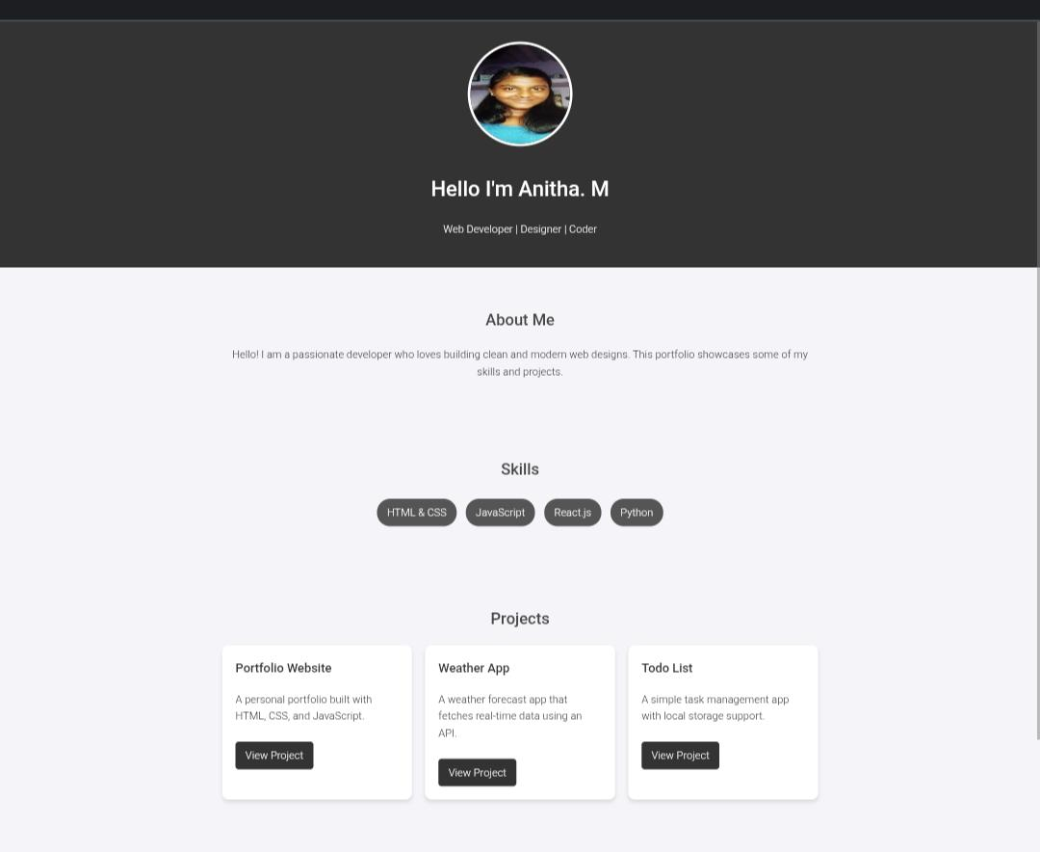

RESULTS AND SCREENSHOTS
3/21/2024 Annual Review
10

Slide 11
CONCLUSION
They are Empowering innovation, one interaction at a time.""Where tradition meets innovation, progress begins.""Together, let's shape a brighter future."Feel free to modify or combine them to fit your presentation's tone and style!
11

